Slide 1
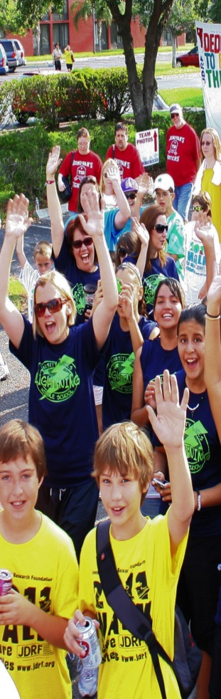

NOT HERE
Notes:
(LOGO SLIDE – DISPLAY ON SCREEN AS STUDENTS ARE GATHERING FOR PRESENTATION)

Slide 2
Thank you for supporting the JDRF Kids Walk Program!
Before you get started, here are a few important things to remember:
Teachers are encouraged to use this presentation to demonstrate how students can use our online fundraising tools.
Students should register and use the site at home with the help of a parent or guardian.
Suggested homework assignments include:
  Registering to receive online donations
  Updating personal page
  Sending fundraising emails through the Participant Center

Slide 3
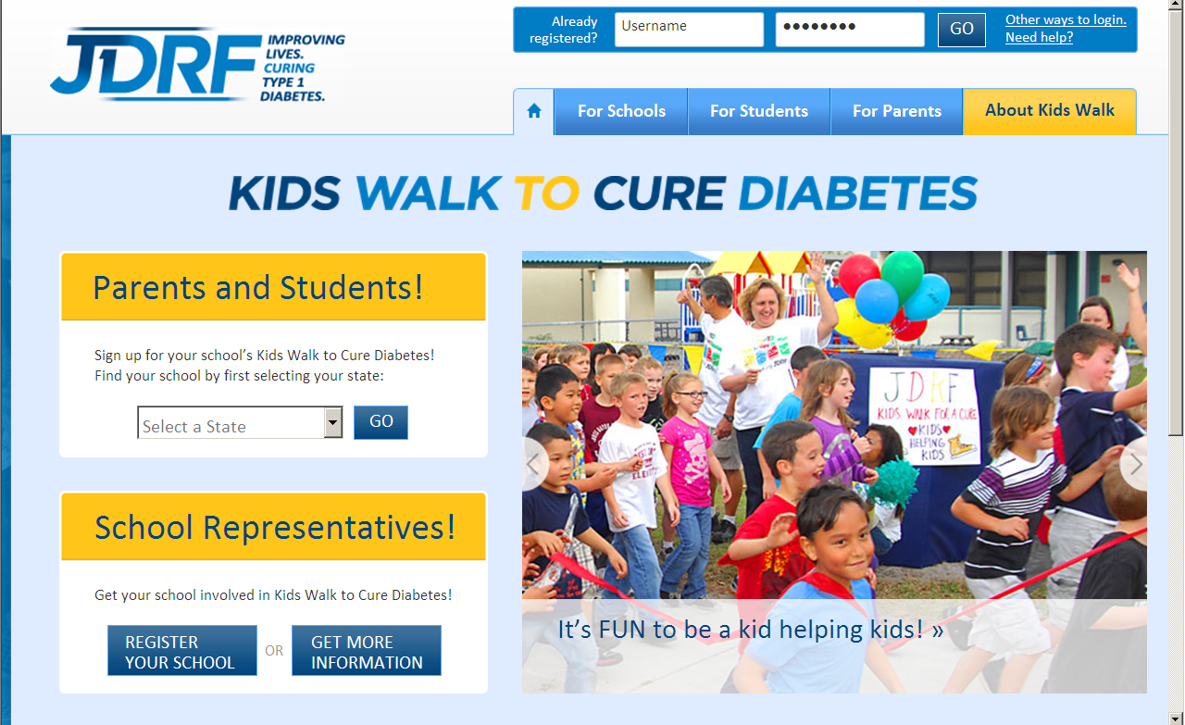

How to Register online for
the upcoming Kids Walk!
Step 1: Go to http://kidswalk.jdrf.org and click “Select Your State”

Slide 4
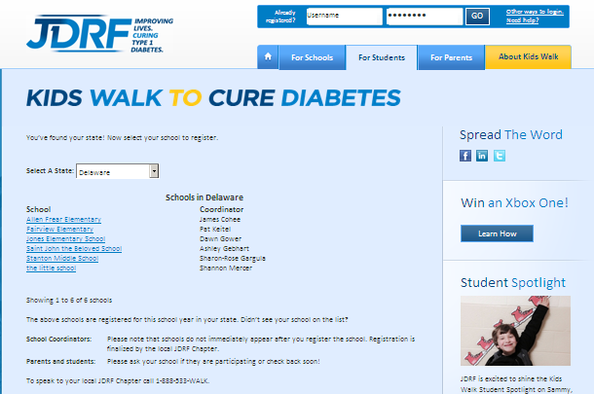
Step 2: Select your school from the list of registered schools.

Slide 5
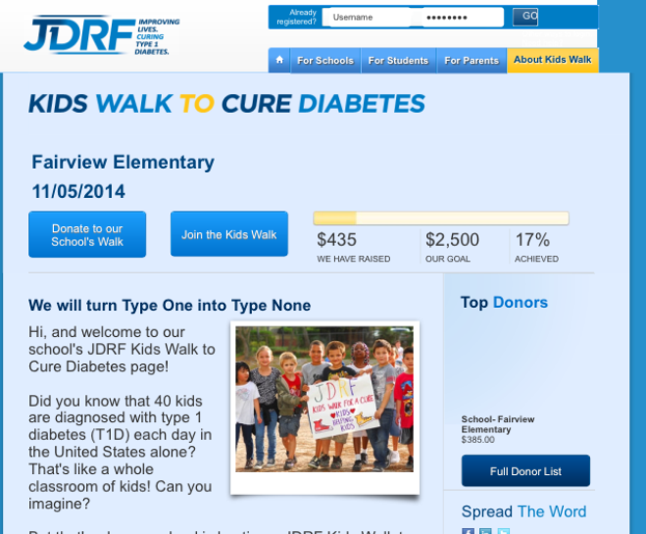
Step 3: Click “Join the Kids Walk”

Slide 6
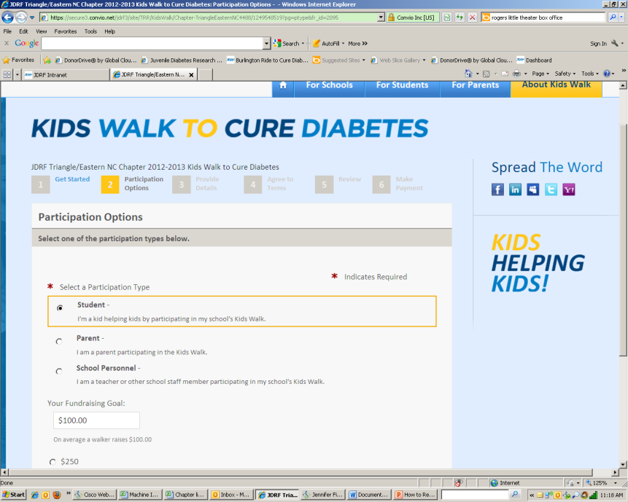
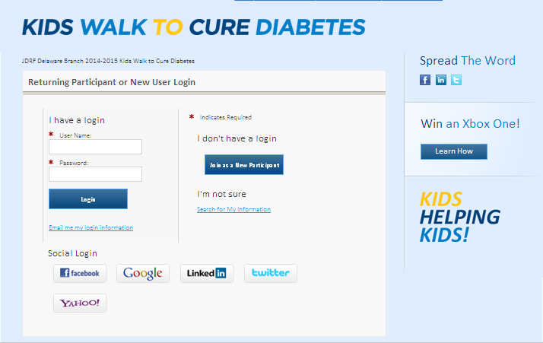
Step 4: Select “Join as a New Participant” and complete registration info

Slide 7
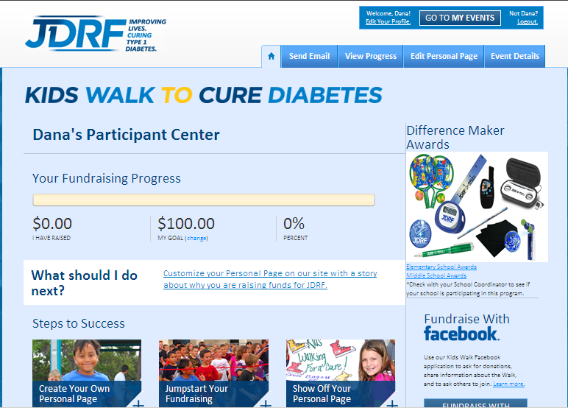
This is your confirmation screen. From here you can personalize your fundraising page, share the campaign on Facebook and much more!

Slide 8

How to share your personal fundraising page with others!

Slide 9
After you register you can login anytime to your account at http://kidswalk.jdrf.org.
Click “Go to My Events” button to give you access to:
Find your registered event
Send email to donors
View who has donated

Slide 10
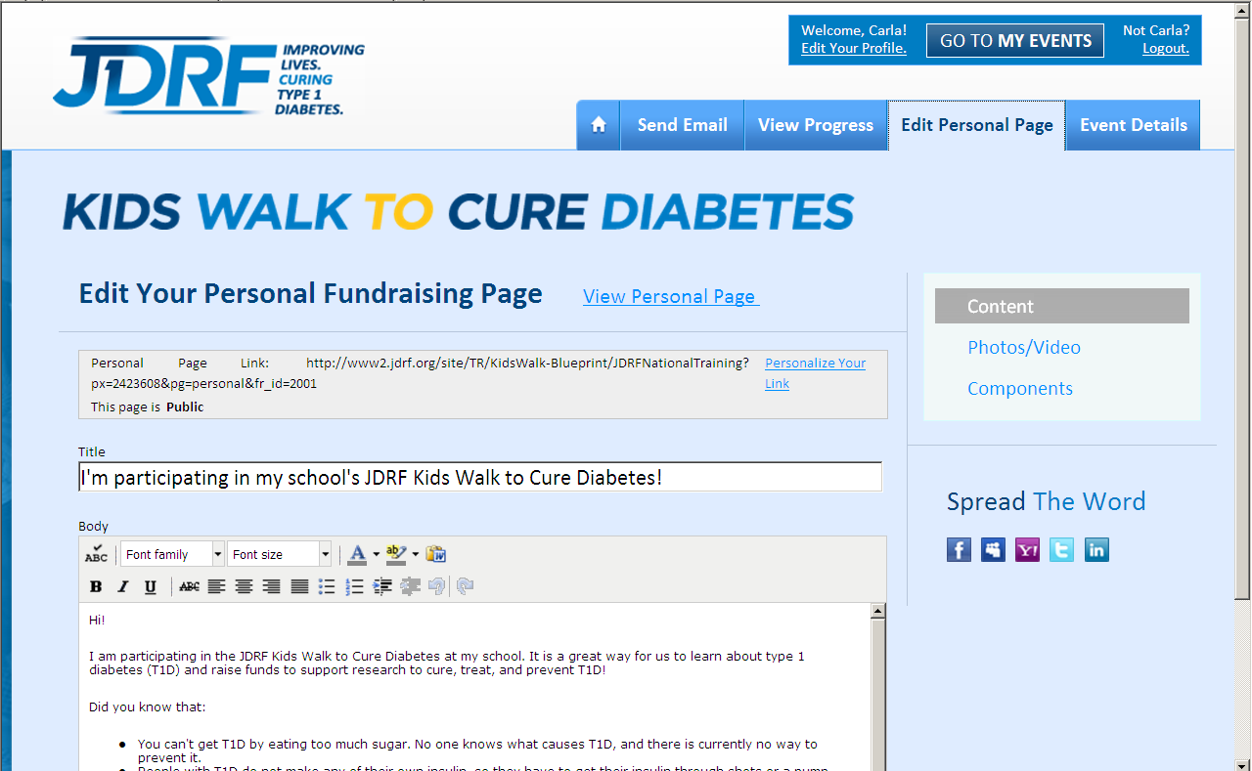
Select the “Edit Personal Page” tab to:
1. Create your own unique URL (website address)
Type a personal message
Upload a photo or video
Spread the word through social media
3
1
4
2

Slide 11
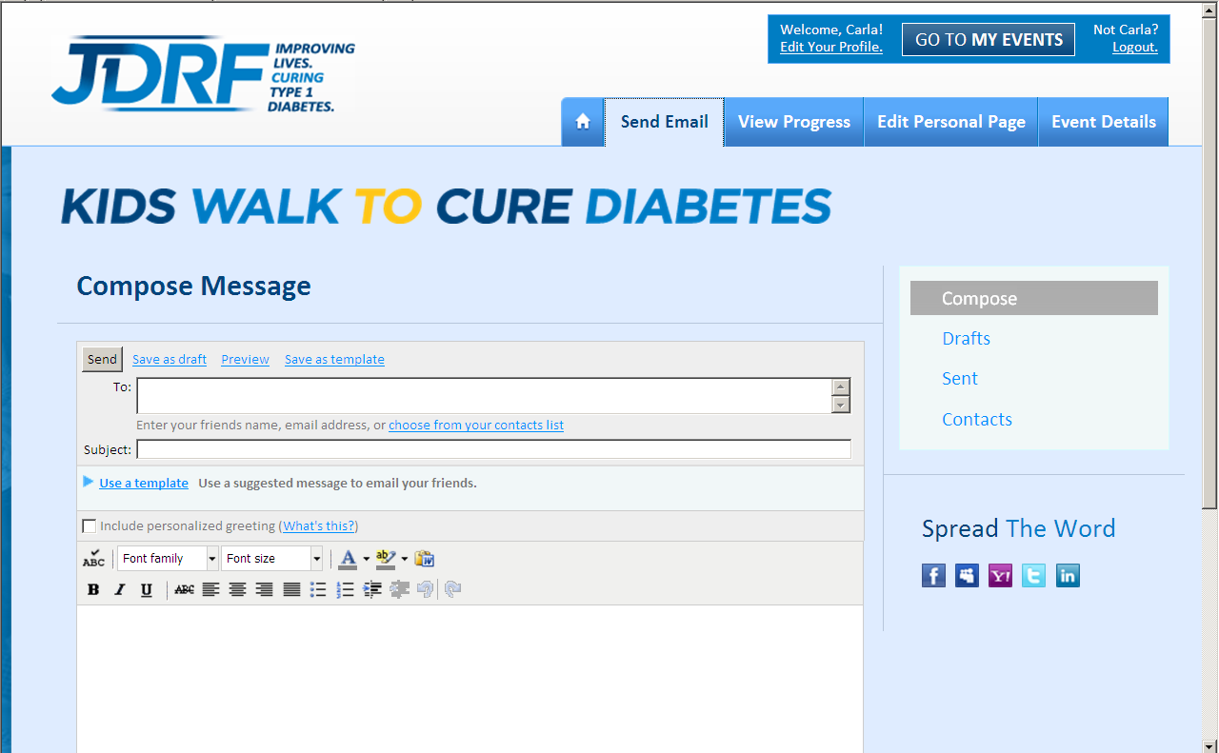
Select the “Send Emails” tab to:
Upload email addresses of family and friends
Send your email with a personal message or use one of our templates.
1
2

Slide 12

Special Opportunity!
Send 10 or more emails to family and friends through your JDRF Kids Walk Participant Center and you’ll be entered for a chance to win an Xbox One! Remember, the emails must be sent through your Participant Center in order to qualify.
To learn more about sending emails through your Participant Center, click here.
For full contest details, click here.

Slide 13
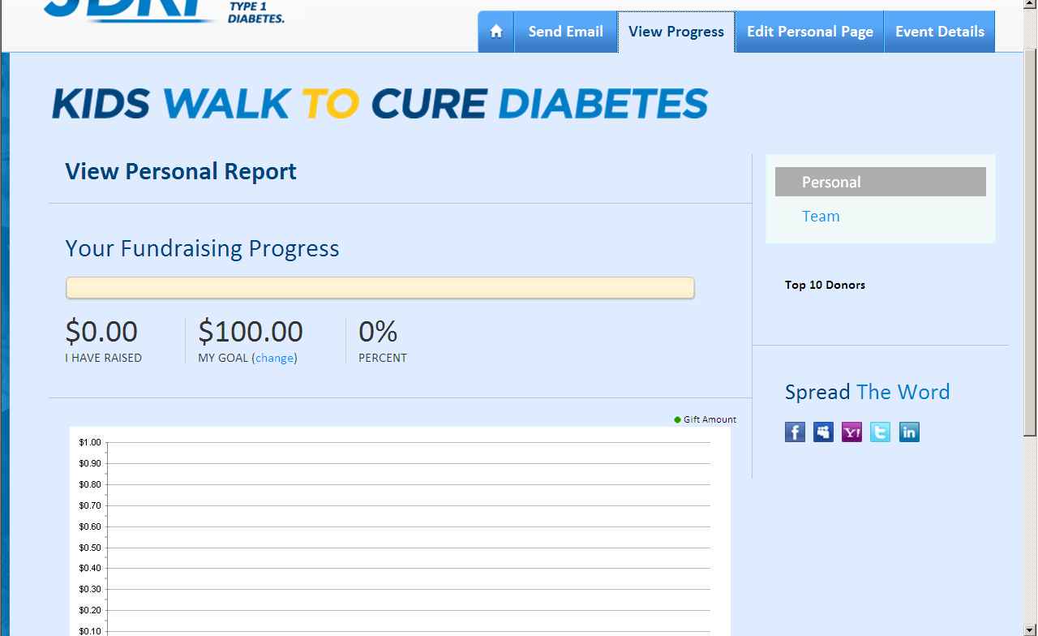
Select the “View Progress” tab to see who is supporting you. Remember to send thank you emails to all your donors!

Slide 14
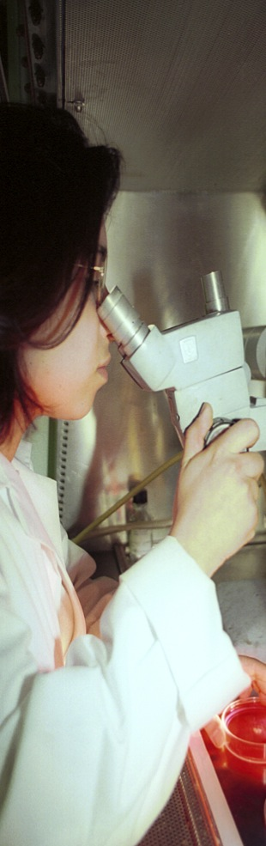


Thanks for being a Kid Helping Kids!
Notes:
Alright everyone — thank you so much for having me here today and for being a great audience! I hope you are excited about helping JDRF and people with T1D! We’ll see you soon, and thank you all so much for being Kids Helping Kids!

